Slide 1
Installation Guide
(IDE – Eclipse 3.5 Java EE)
2009. 07. 17
CODELABOR
Shin Sang Jae (codelabor@gmail.com)

Slide 2
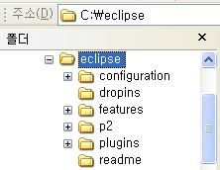
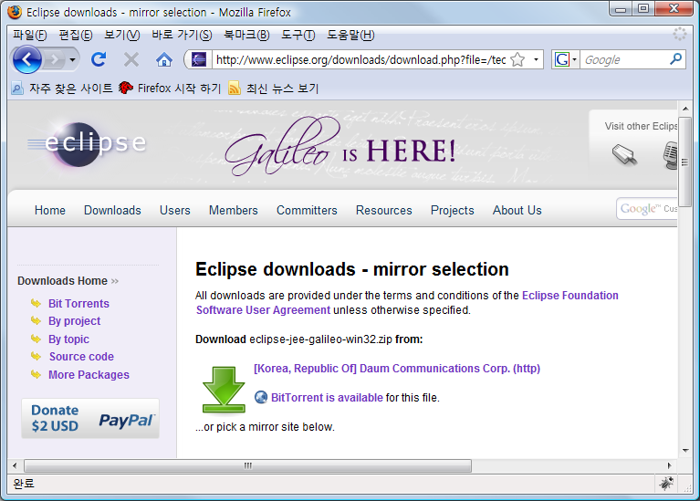

IDE
Installation
Official Site: http://www.eclipse.org/downloads/
Package: Eclipse IDE for Java EE Developers
File: eclipse-jee-galileo-win32.zip
Unzip Directory: C:\
Installation Directory: C:\eclipse

Slide 3
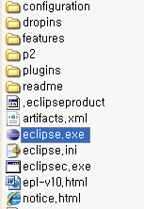
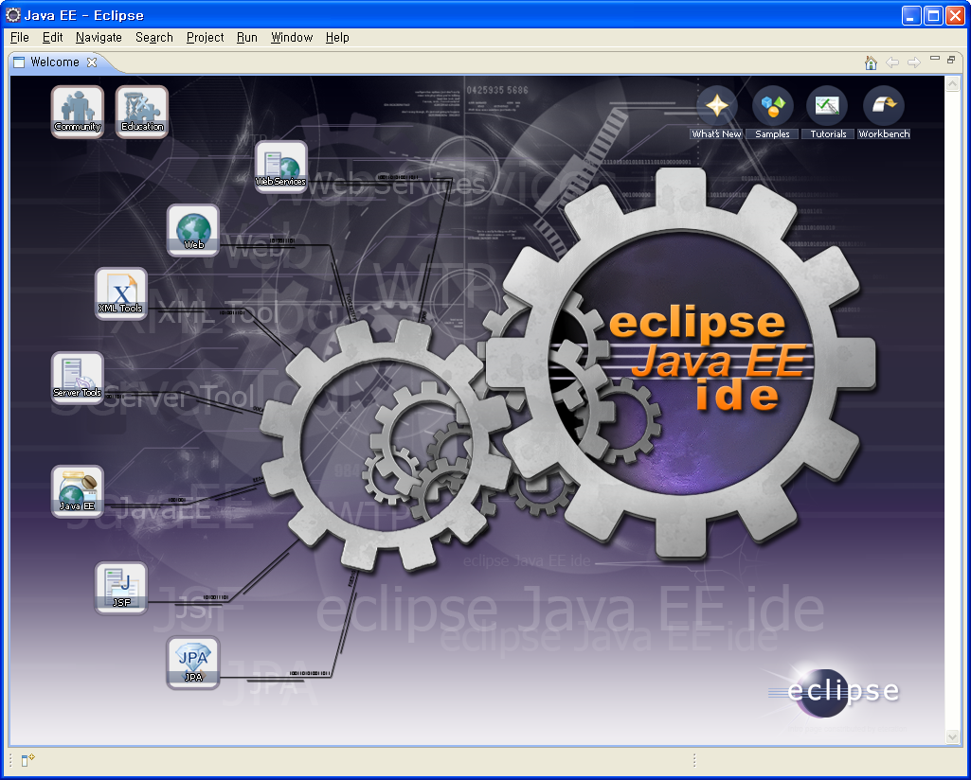

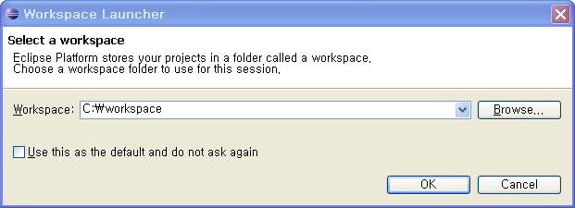
IDE
Run
Executable File: eclipse.exe
Workspace Directory: C:\workspace

